Slide 1
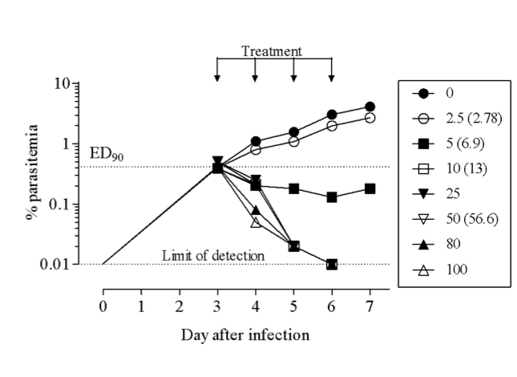
A
B
MMV639565
R¹ = H, R² = Cl
Pf IC₅₀ = 0.091 µM
MMV669844
R¹ = OCH₃, R² = CN
Pf IC₅₀ = 0.040 µM
MMV670652
R¹ = OCF₂H, R² = CN
Pf IC₅₀ = 0.017 µM

